Slide 1
CUSTOMER CHURN REDUCTION USING SUPPLY CHAIN ANALYTICS
PROJECT REPORT SUBMITTED BY
ARUN RICHARD A
BINOY GEORGE
DHANUSH KH
RISHABH BHARDWAJ
SANJAY DEY
GUIDED BY MR.SUBRAMANIAN P V

Slide 2
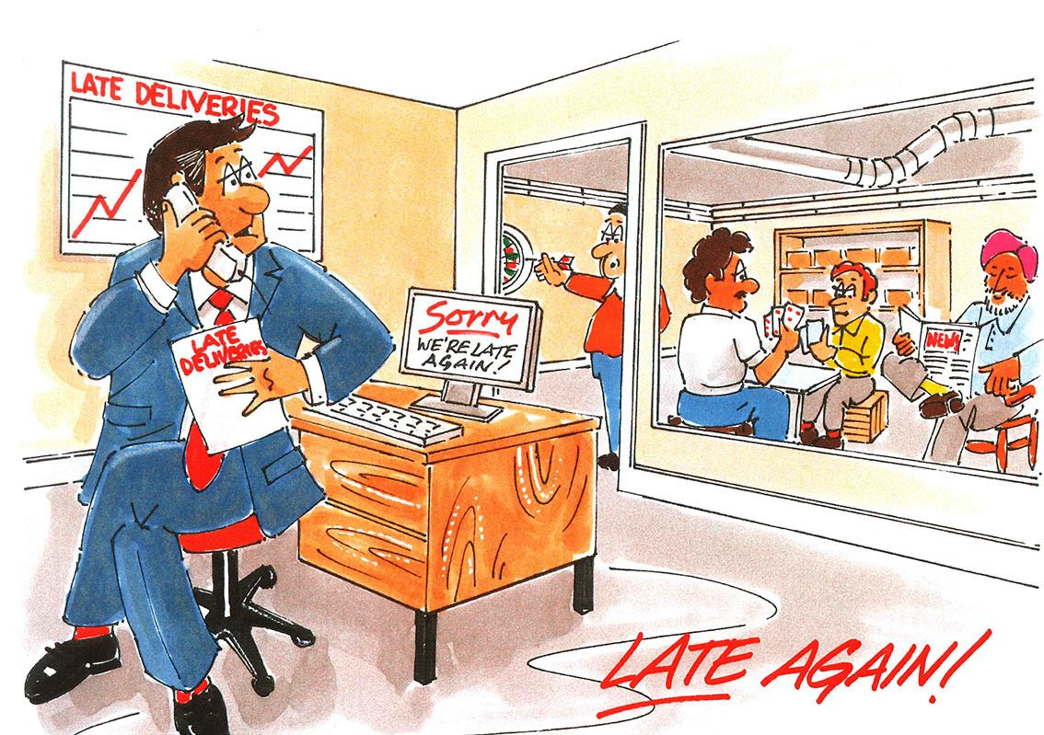
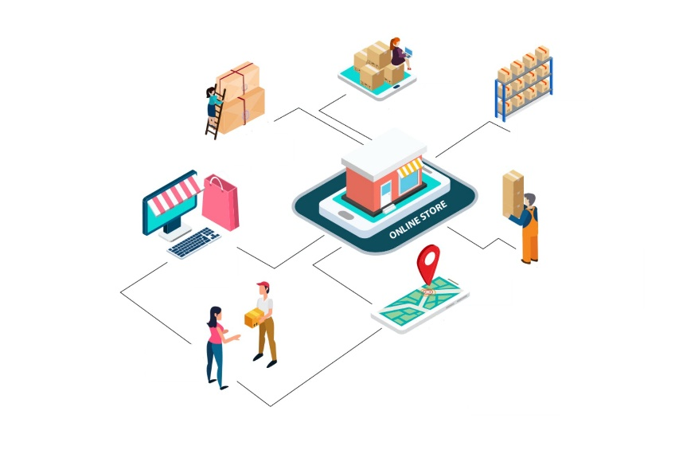
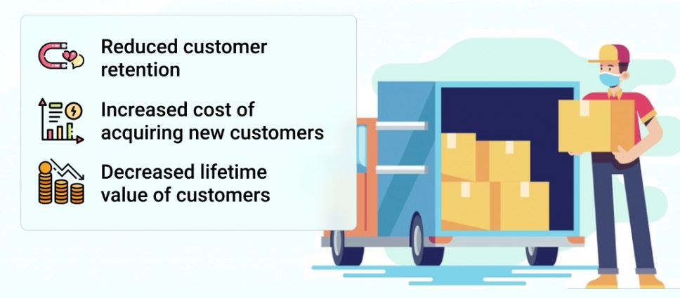
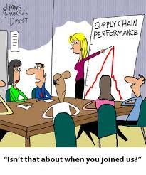
PROBLEM DEFINITION
SUPPLY CHAIN
LATE DELIVERY
CUSTOMER CHURN
DROP IN SALES

Slide 3



HELP A BUSINESS BETTER PREDICT FUTURE DEMAND
HOW TO INCREASE THEIR BUSINESS REVENUE
REDUCE CUSTOMER CHURN

Slide 4
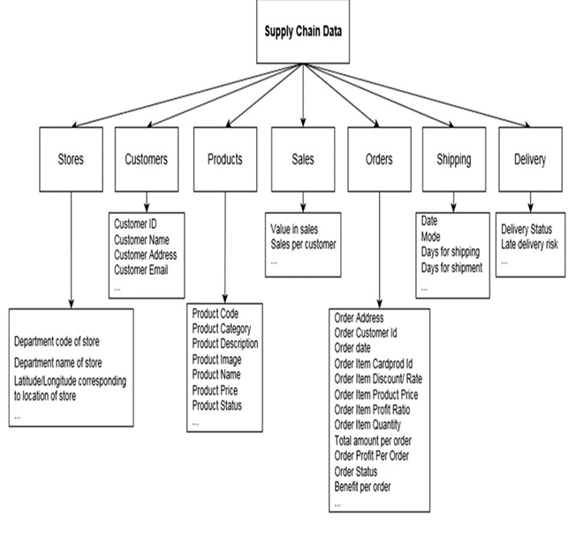
DATASET
Dataset used: supply chain dataset
Total number of rows: 180519
Total number of columns: 53
Numerical features : 29
Categorical features : 24
Missing values:
Customer lname has 8 missing values which .004%
Customer zipcope has 3 missing values which is .002%
Order zipcode has 155679 missing values which is 86.24%
Product description has 180519 missing values which is 100%

Slide 5
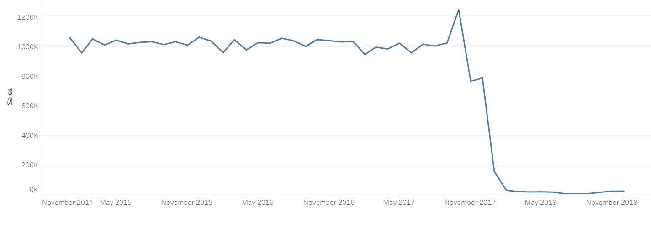
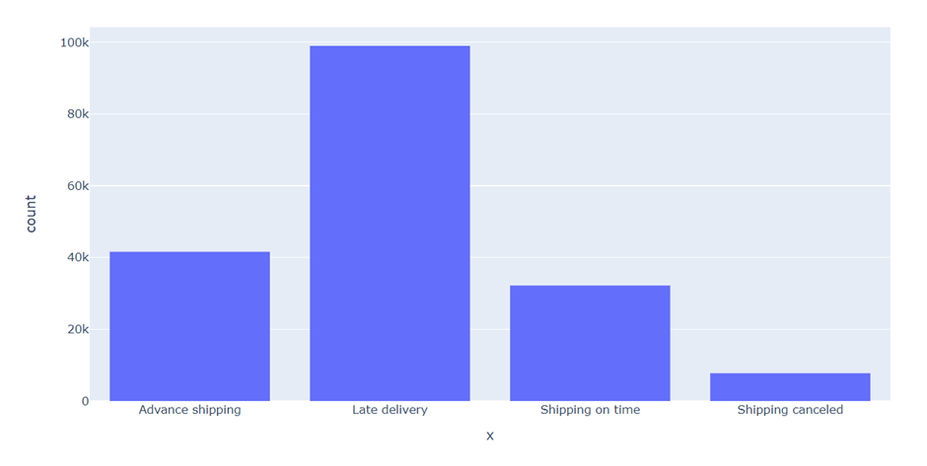
Problem :
Increase in Customer churn.
Cause :
Late Delivery
Decrease in Sales
Solution for the defined Problem
A Model to predict late delivery risk.
Target Variable : “Late delivery risk”.
Classes:
0 - Late Delivered Orders
1 - Non Late Delivered Orders

Slide 6
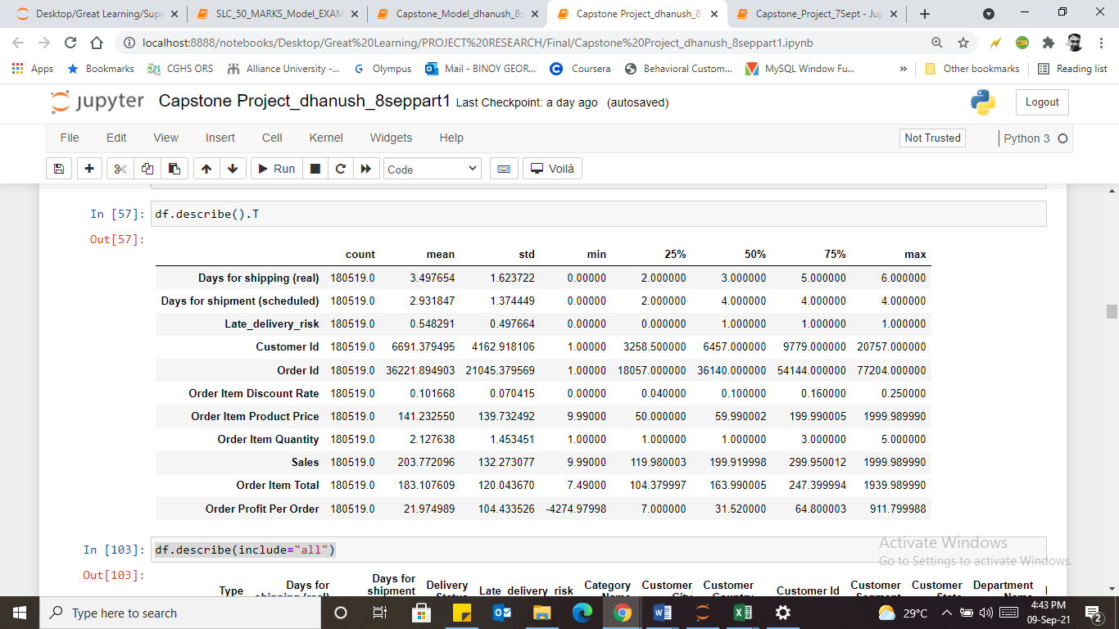
EXPLORATORY DATA ANALYSIS
‘Type’- 4 types of transactions majority - debit
‘Days for shipping (real)’ and ‘days for shipment (scheduled)’-the average actual shipment time > the average scheduled shipment time.
Delivery status- > 50% of the orders are late delivery

Slide 7
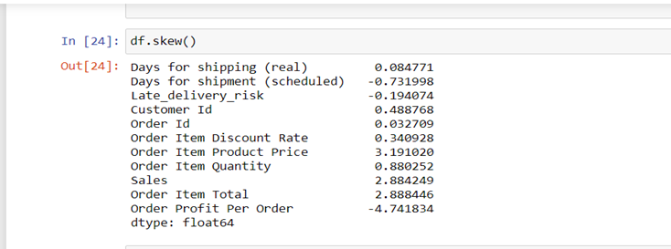
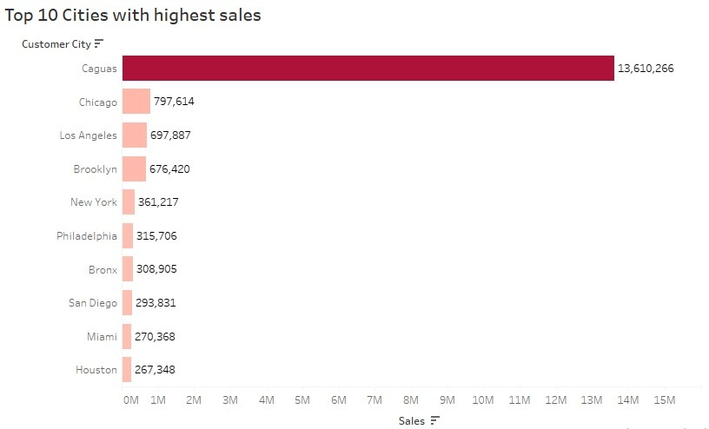
Skewness in data:
Order profit per order is left skewed.
Order Item product price is right skewed.
Data Visualization:
Caguas Customer City with high sales.

Slide 8
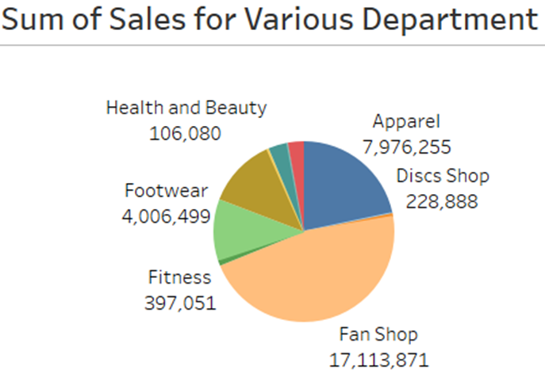
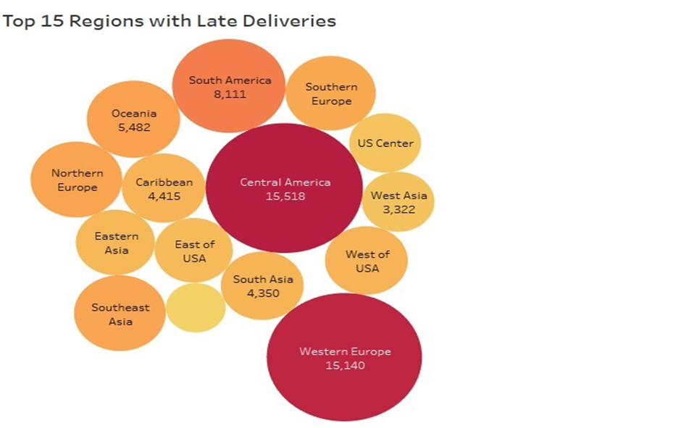
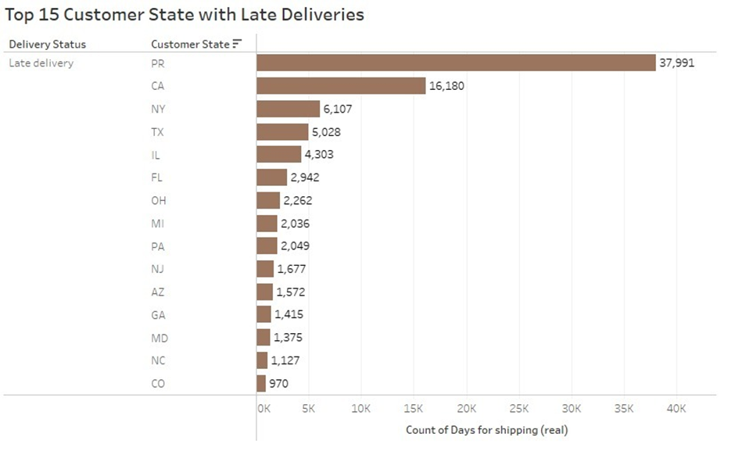
Fan shop and apparel departments have produced high sales
Central America and Western Europe regions have highest percentage of late deliveries
PR and CA customer states showing high late deliveries

Slide 9
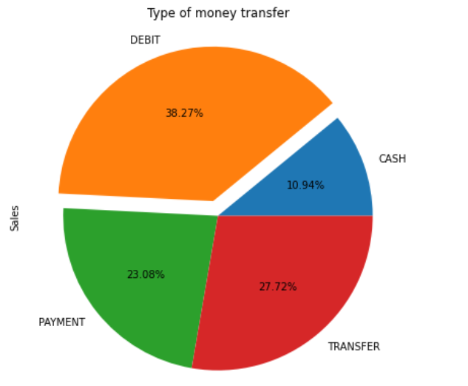
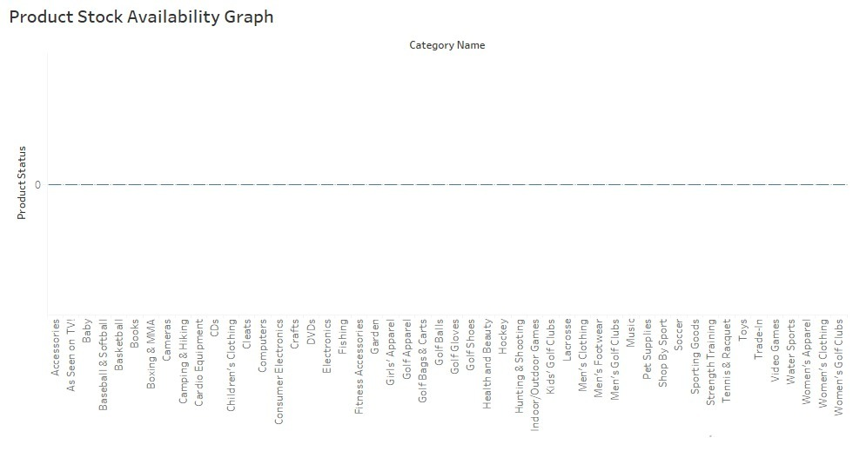
Graph showing that each and every product is on stock
Major money transfer is through debit mode comparatively

Slide 10
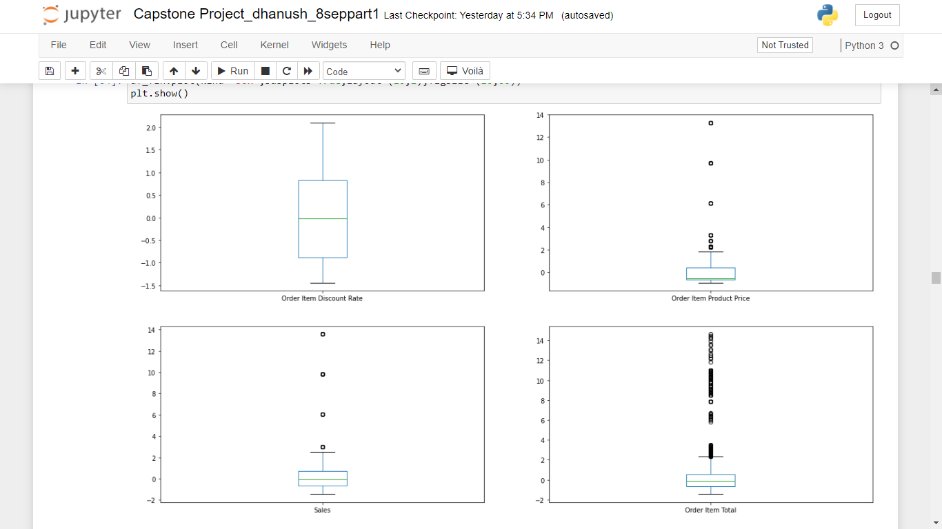
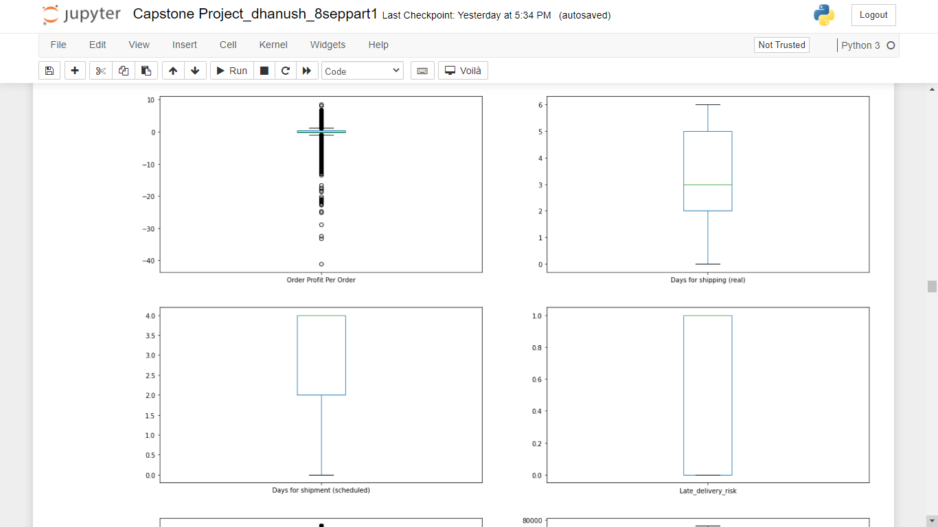
OUTLIER ANALYSIS

Slide 11
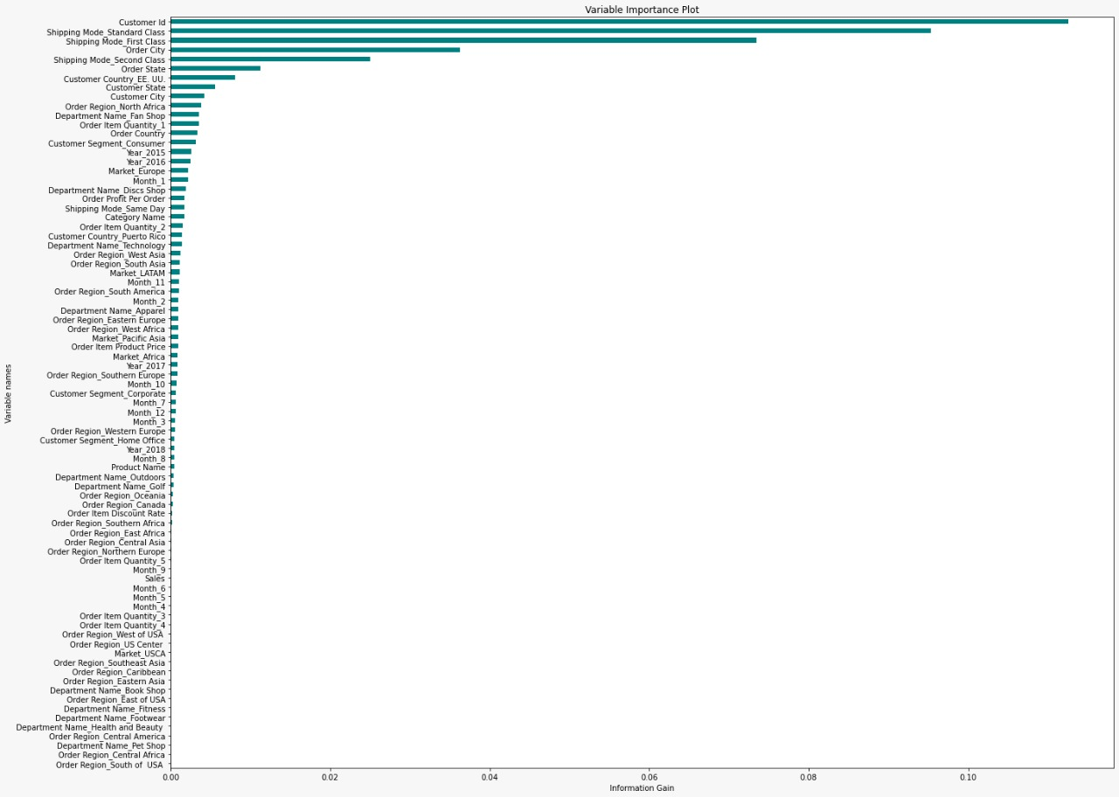
Feature Engineering
Redundancy
Missing values
Low variance
Outlier treatment (IQR)
Data Imbalance
One-Hot Encoding
Standard normalization
Feature Selection
Information gain
Chi-2 test :
Year and Month
Label Encoding
Order region
Order city
Order state
Customer city

Slide 12
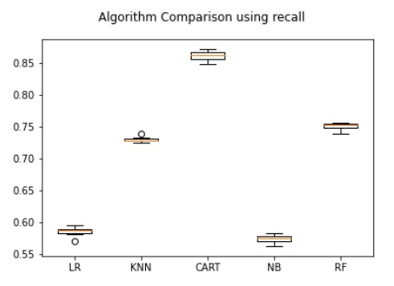
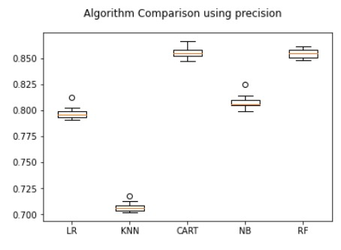
ALGORITHM COMPARISON
Model | Training Precision_1 | Testing Precision_1 | Training Recall_1 | Testing Recall_1 | Training f1_weighted | Testing f1_weighted | Training Accuracy | Testing Accuracy | AUROC Train | AUROC Test
Unpruned decision Tree | 1 | 0.84 | 1 | 0.84 | 1 | 0.82 | 1 | 0.82 | 1 | 0.82
depth tuned decision Tree | 0.99 | 0.83 | 0.99 | 0.83 | 0.99 | 0.82 | 0.99 | 0.81 | 0.99 | 0.82
cutoff tuned decision tree | 0.89 | 0.79 | 0.99 | 0.8 | 0.98 | 0.79 | 0.99 | 0.81 | 0.99 | 0.82
Logistic regression without tuned cutoff | 0.56 | 0.56 | 0.87 | 0.87 | 0.49 | 0.49 | 0.55 | 0.55 | 0.52 | 0.52
Logistic regression with tuned cutoff | 0.48 | 0.48 | 0.72 | 0.72 | 0.576 | 0.56 | 0.53 | 0.52 | 0.55 | 0.54
KNN Model untuned | 0.75 | 0.67 | 0.79 | 0.71 | 0.74 | 0.65 | 0.74 | 0.65 | 0.73 | 0.64
KNN Model tuned | 0.85 | 0.72 | 0.86 | 0.74 | 0.84 | 0.7 | 0.84 | 0.7 | 0.84 | 0.7
KNN Model tuned with cutoff | 0.7 | 0.59 | 0.95 | 0.85 | 0.81 | 0.69 | 0.79 | 0.67 | 0.81 | 0.69
Random Forest untuned | 1 | 0.85 | 1 | 0.68 | 1 | 0.78 | 1 | 0.76 | 1 | 0.77
Random Forest tuned | 1 | 0.85 | 1 | 0.68 | 1 | 0.76 | 1 | 0.76 | 1 | 0.77
Random Forest tuned with cutoff | 0.99 | 0.65 | 1 | 0.9 | 0.99 | 0.75 | 0.99 | 0.74 | 1 | 0.75
AdaBoost untuned | 0.85 | 0.85 | 0.54 | 0.68 | 0.69 | 0.76 | 0.7 | 0.76 | 0.71 | 0.76
AdaBoost tuned | 0.85 | 0.85 | 0.54 | 0.54 | 0.69 | 0.69 | 0.7 | 0.7 | 0.71 | 0.71
GradientBoost untuned | 0.84 | 0.84 | 0.55 | 0.55 | 0.69 | 0.69 | 0.7 | 0.7 | 0.71 | 0.71
GradientBoost tuned with cutoff | 0.8 | 0.77 | 0.84 | 0.7 | 0.81 | 0.73 | 0.84 | 0.77 | 0.83 | 0.76
GradientBoost Final Tuned Model | 1 | 0.92 | 0.99 | 0.7 | 0.97 | 0.88 | 0.99 | 0.88 | 0.99 | 0.89

Slide 13
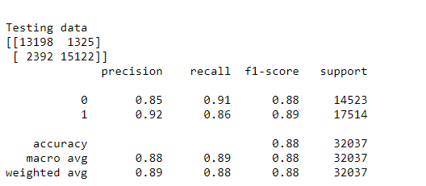
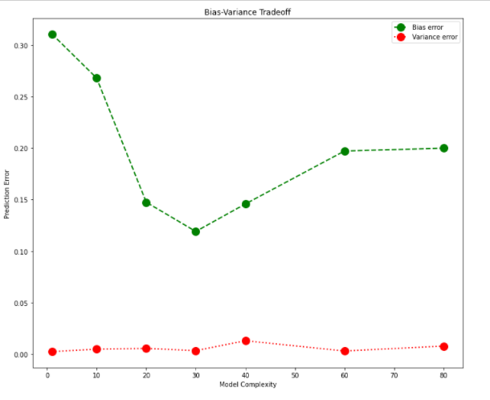
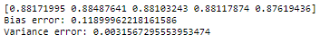
GRADIENT BOOSTING ALGORITHM
Test Results
Pros
Reduce bias
Reduce variance
Flexible
Cons
Computationally expensive
Tend to overfit
Difficult to interpret
Bias And Variance error

Slide 14

SOLUTION ARCHITECTURE
API like Flask/Heroku
Order Delivery Booking App/Website
Database
Business Access API
Information capture and predictions
POTENTIAL FOLLOW UP PROJECT
CUSTOMER SEGMENTATION

Slide 15
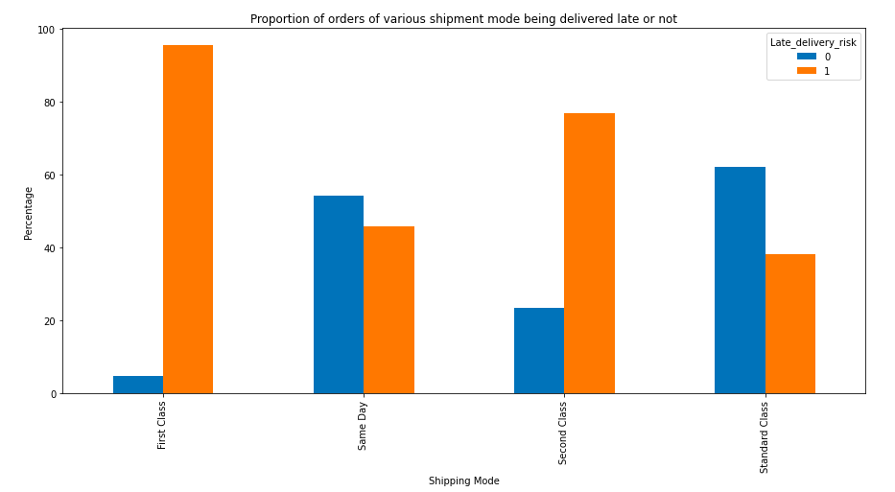
Significant Features
Shipping mode
Customer city
Order city
Order state
Customer state
Order country
Conclusion
Late_delivery_risk | Order_city | Order_city | Order_city | Order_city
1 | Almaty | Ercolano | Madero | Rennes
1 | Ancona | Getafe | Mantes-la-Jolie | Rotherham
1 | Apucarana | Glasgow | Mersin | Salamanca
1 | Araçatuba | Gradignan | Milan | San Francisco de Macorís
1 | Bhopal | Gujranwala | Naples | Santa Cruz do Sul
1 | Bologna | Guzmán | Pamiers | Shiraz
1 | Carcassonne | Gy Ę r | Pekín | São Miguel dos Campos
1 | Chesterfield | Huixquilucan | Pierrefitte-sur-Seine | Thonon-les-Bains
1 | Clarksville | Istres | Pirapora | Villahermosa
1 | Cuajimalpa | Itapecuru Mirim | Port Macquarie | Villeurbanne
1 | Cuscatancingo | Ivano-Frankivs'k | Posadas | Wiesbaden
1 | Cárdenas | Kingswood | Recife | Yantai
Significant order cities with high late delivery risk

Slide 16

THANK YOU !
ANY QUESTIONS ?

